Slide 1

STRATEGIC INITIATIVES RAILWAY DEVELOPMENT PLAN
TYPE | PROJECTS | PHASE | ESTIMATED INVESTMENTS (MM USD)
New Service | Melipilla – Estación Central |  | 1.889
New Service | Quinta Normal – Batuco |  | 951
Cargo | Barrancas Intermodal Terminal (Phase 1 Rail-Port Logistics Platform) |  | 79
Replacement | New Biobío Railway Bridge |  |  | 268
Improvement | Chillán – Estación Central |  |  | 150
New Service | Ext. Quillota – La Calera |  | ​880
New Service | Concepción-Lota |  | 170
2022 2023 2024 2025 2026 2027 2028 2029 3030 3031
EJ
Obras iniciales
OOCC Tramos
22 Trenes
Inicio Operación T1
Inicio Operación T2 2030
EJ
OOCC Tramos
10 Trenes
Inicio Operación T1
Inicio Operación T2 2031
EJ
Obras
Inicio operación
Q1 2026
EJ
Obras
Inicio operación
Q4 2025
EJ
Obras
Inicio operación
Q1 2026
6 Trenes
DI
RCA
Obras
15 Trenes
Inicio Operación T2 2029
DI
Implementación
RCA
Inicio Operación Q2 2030
Obras
3 Trenes
Empresa de los Ferrocarriles del Estado
Notes:
Meta: 150 millones pasajeros en 2032
Proyectos clave:
Alameda–Melipilla
Quinta Normal–Batuco
Ampliación Valparaíso y Biotren
Meta: 6 mil millones TKBC en 2029

Slide 2
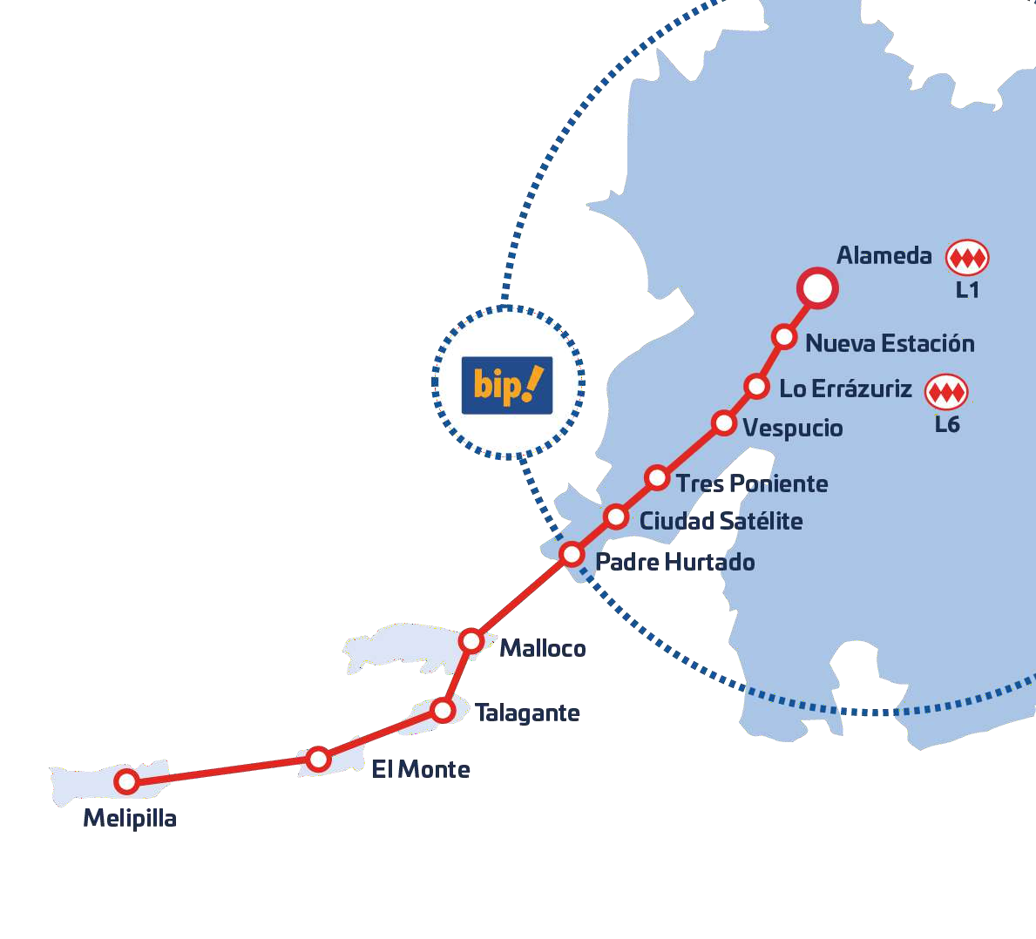














MELIPILLA – SANTIAGO TRAIN
1.137.000
Beneficiary Population
8
Municipalities Covered
22
New Trains
57.000.000
Passengers per Year
61 KM
Total Extension
11
Stations
Estación
Central
ESTACIÓN CENTRAL – CIUDAD SATÉLITE
17 min
1h
43m
ESTACIÓN CENTRAL – MALLOCO
21 min
1h25m
1h04m
ESTACIÓN CENTRAL – MELIPILLA
46 min
2h00m
1h14m
Empresa de los Ferrocarriles del Estado
Notes:
Doble vía hasta Malloco / Nueva Vía de Carga hasta Malloco, después se rehabilita.
Bucles Malloco / Talagante / Melipilla

Slide 3
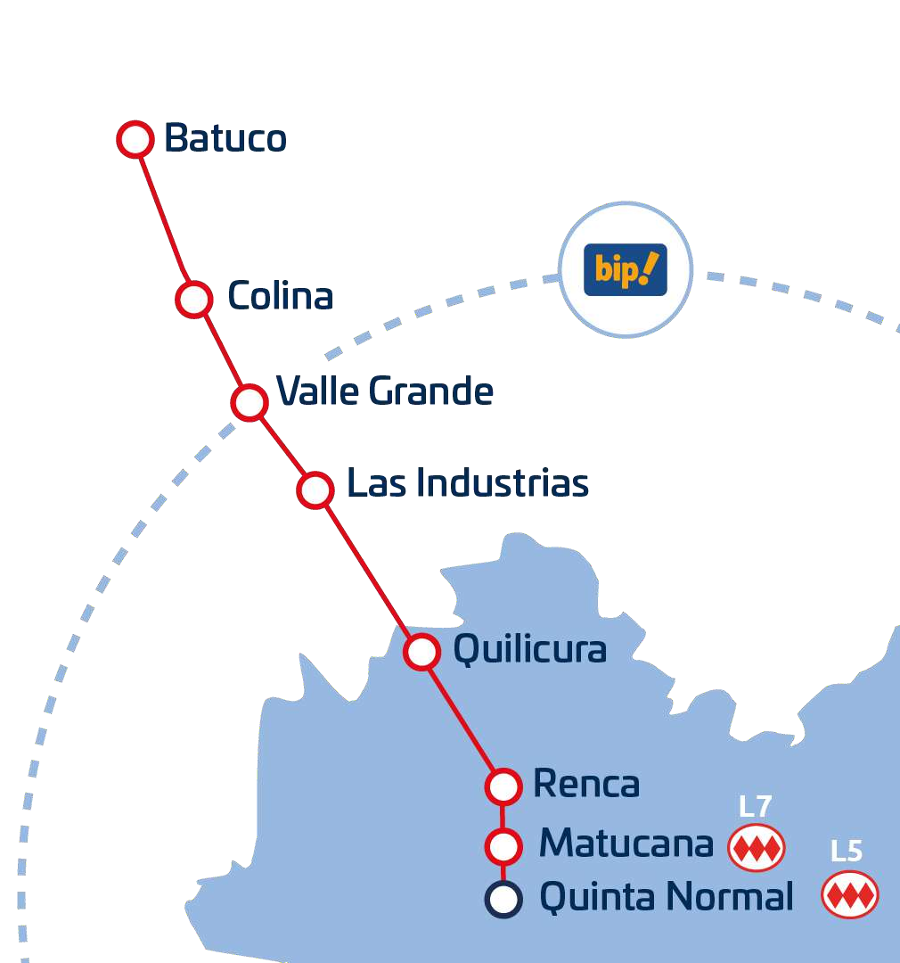











BATUCO – QUINTA NORMAL TRAIN
590.000
Beneficiary Population
6
Municipalities Covered
11
New Trains
35.000.000
Passengers per Year
27 KM
Total Extension
8
Stations
QUINTA NORMAL - BATUCO
23m
1h30m
1h7m
QUINTA NORMAL - TILTIL
49m
2h30m
1h41m
Empresa de los Ferrocarriles del Estado

Slide 4
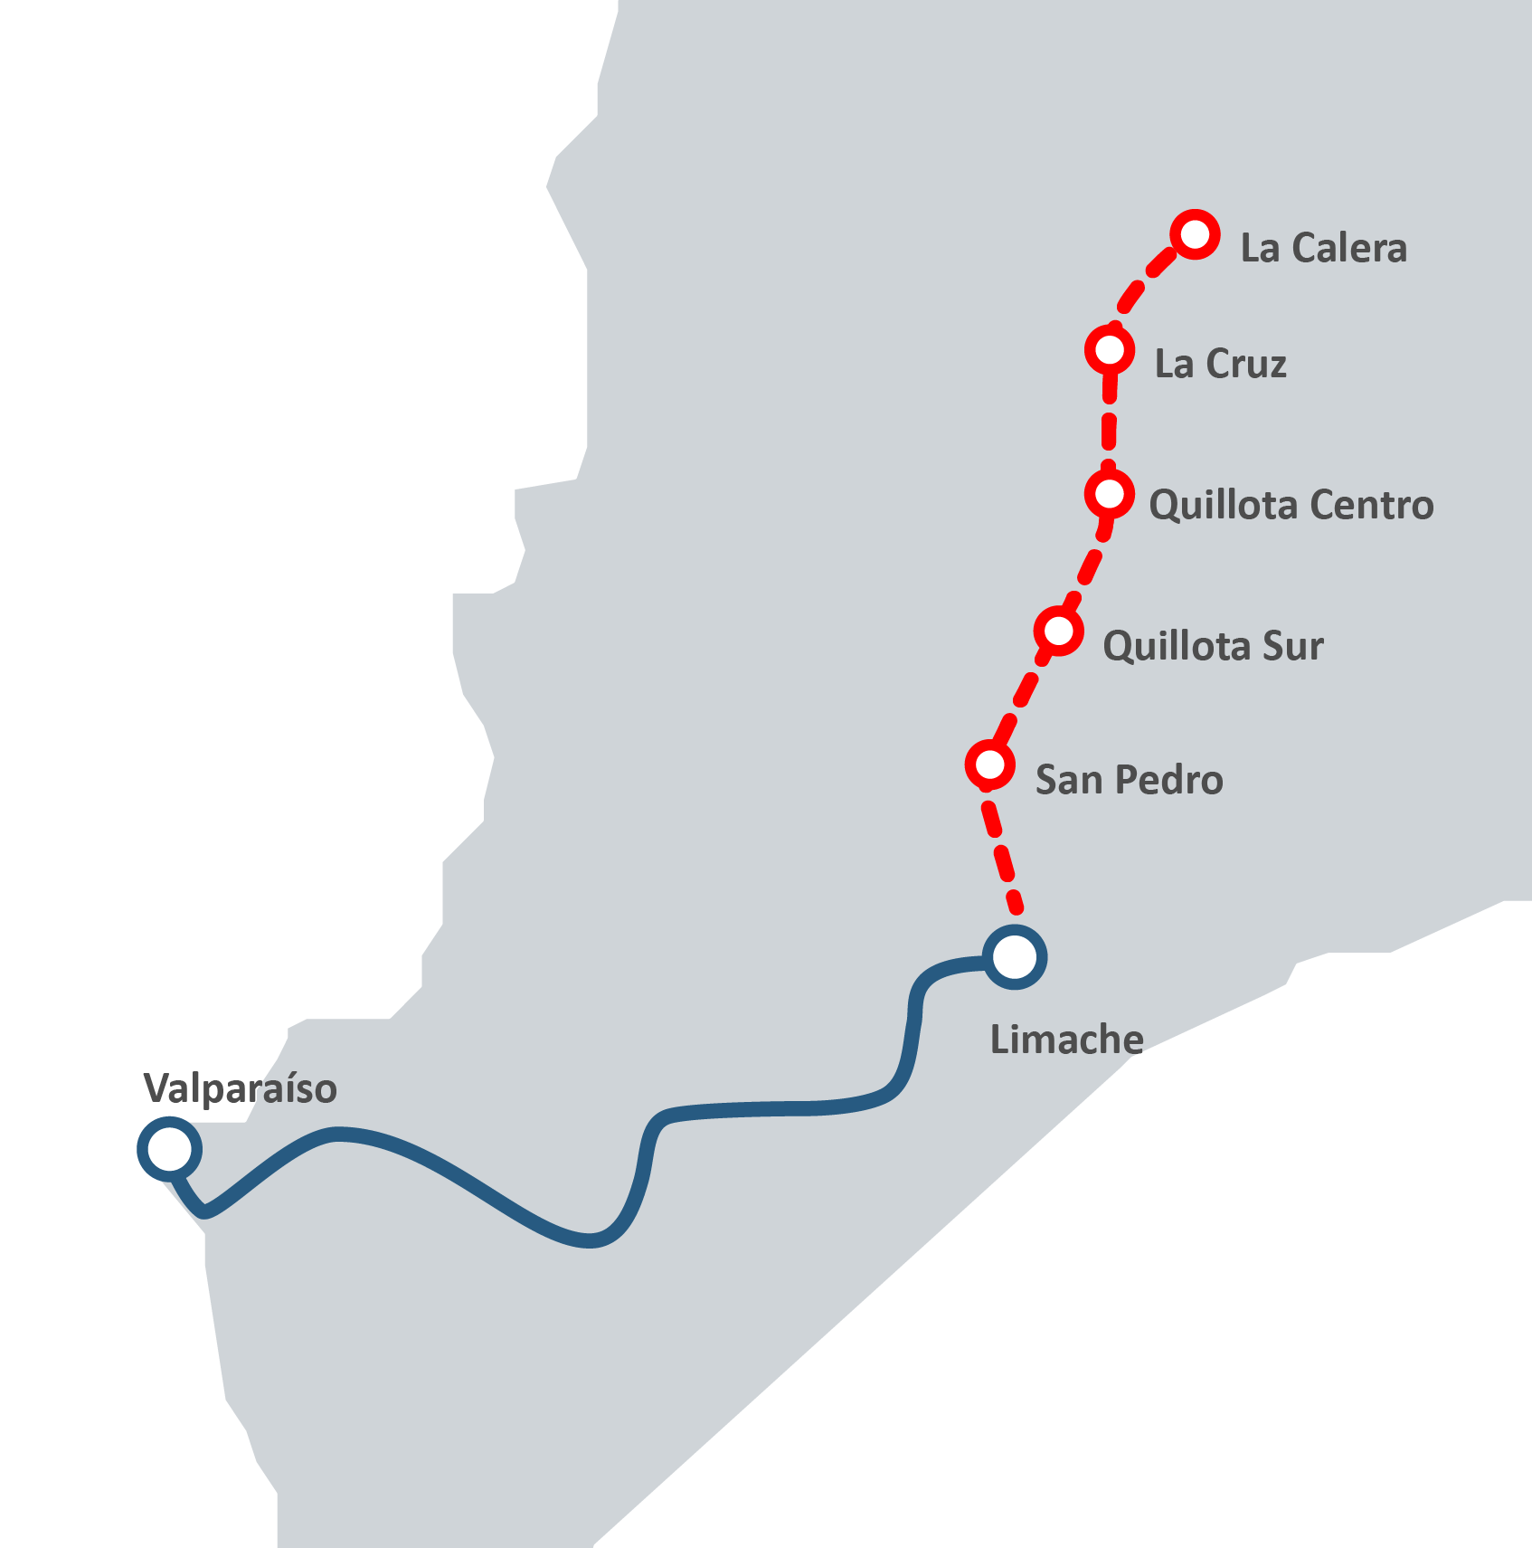
LIMACHE – QUILLOTA – LA CALERA EXTENSION
1.118.449
Beneficiary Population
8
Municipalities Covered
15
New Trains
12.000.000
Passengers per Year
26 KM
Total Extension
6
Stations
LIMACHE – LA CALERA / Morning Rush Hour
19m
55m
36m
PUERTO - LA CALERA / Morning Rush Hour
1h14m
3h11m
1h40m
Empresa de los Ferrocarriles del Estado

Slide 5

CAPACITY EXPANSION AND EXTENSION CORONEL – LOTA
1.105.658
Beneficiary Population
3
Municipalities Covered
Talcahuano
10
New Trains
10.000.000
Passengers per Year
9 KM
Total Extension
5
Stations
JP II
Concepción
Diagonal Biobío
CONCEPCIÓN – LOTA
Alborada
Costa Mar
El Parque
Lomas Coloradas
50m
1hr15m
25m
R. Silva Henríquez
  Capacity Expansion Phase I: Execution. Procurement of 10 double trains, platform extension, tracks, signalling, and catenary reinforcement.
  Capacity Expansion Phase II: easibility. Electrical Substation, New Workshop, and Depots.
  Extension to Lota: 4 new stops (Coronel Sur, Chiflón, Cousiño, Lota) + 1 seasonal stop (Playa Blanca).
Hito Galvarino
Los Canelos
Huinca
Hualqui
Cristo Redentor
Quiñenco
Coronel
Lota
Empresa de los Ferrocarriles del Estado

Slide 6
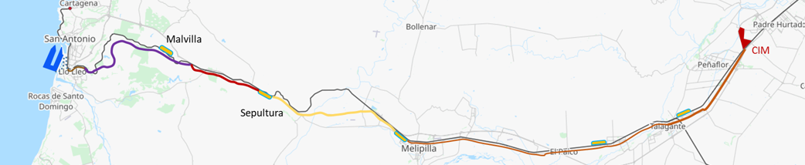






RAIL-PORT LOGISTICS PLATFORM
PROJECTS
Long-Term Project | Current Phase
Improvement of the corridor for 1,250-meter double-stack trains | Feasibility
Metropolitan Intermodal Transfer Center | Feasibility
1
ALAMEDA–SAN ANTONIO FREIGHT CORRIDOR
2
INTERMODAL TRANSFER CENTER
  Second Track of the Freight Corridor for 1,250-meter Trains, with an Operational Speed of 60 km/h
  Administrative and Operational Buildings
  Construction of 4 Tunnels for Double Track and Double-Stack Trains (7,640 m)
  Automated Equipment for Operations
  - Construction of 30 km of new tracks.
  - Six-Track Railway Grid.
  - Upgrading 18 Level Crossings to Grade-Separated Intersections.
Phase Investment Amount | UF 777.437
Project Investment Amount | UF 51.800.000
NEXT STEPS
  Feasibility Engineering Studies and Advisory Services for the Expansion of the Freight Corridor for 1,250-Meter Trains
Empresa de los Ferrocarriles del Estado

